Slide 1

ABFRL Brand - Generic App Tagging
5th May 2025

Slide 2
Guidelines to Implement Tagging
Adobe Launch SDK should be implemented to trigger the custom events​
​
Copy and paste the contextData as it is without changing the Camel Casing.​
​
All values should be passed in lowercase.​​
​
Context data should be fired with specific event.​
​
<> this indicates dynamic value to be captured and passed.​​
​
For Customer ID, pass the value only when available else pass it as blank.

Slide 3
Super App Brands
Since Super App contains multiple cross-brands journey, therefore w.r.t to tracking the brand/product brand currently included( PFB the table with the expected value to be passed in the context data)
Brand/Product Brand | Datalayer Value
Van Huesen | vh
Peter England | pe
Allen Solly | as
Louis Phillipe | lp
Reebok | rbk
American Eagle | aeo
Simon Carter | sc

Slide 4

Generic Tags

Slide 5
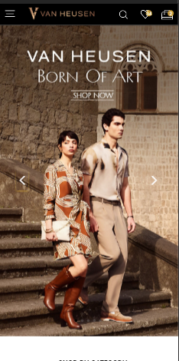
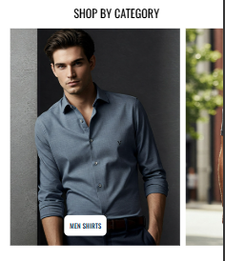
On any banner/widget click

Slide 6
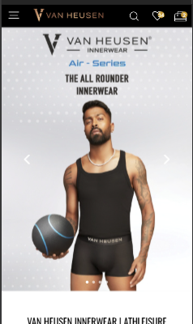
Click Type | Tracking Type | Launch variables | Expected Values
Any Banner click or Widget click | All CTAs | const xdmData = {'eventType': 'analytics.track'}; const adobeDatalayer = { __adobe:{ analytics:{ linkType: 'o', contextData:{ linkName : "<banner click/widget click“>, channel: "<android/ios>|<page name without the word "page">", // eg : home, category,etc. customerID : "<customerID>", // only pass when available linkPageName: "<page name>", //the name of the page from where the product was clicked, eg : home page, product listing page , etc. loginStatus : "<logged-in/guest>" , brand: "<brand name>", icid : "<page type>-<brand name>|<banner name>|<widget name>|<cta name>|<banner/widget position>|<banner/widget type> | <sub brand>", //if a banner or widget is clicked, Please pass subrand as vhiw only for vhiw innerwear site, for rest pass na platform: "<android/ios>", userDetails: "<gender>|<age>", // pass only when user is logged in dob: "<date of birth>", // pass only when user is logged in eventType: 'click' } } } }; let experienceEvent = new ExperienceEvent({ xdmData: xdmData, data: adobeDatalayer }); Edge.sendEvent(experienceEvent) | loginStatus may have the values:- logged-in guest icid will be passed when a banner or widget is clicked. icid should always be passed in the given format only. Pass na if any value is missing. Example value :- home page-vh|born of art men|na|banner click|1|hero banner|na home page-vh|air series updated banner |na|banner-click|2|hero-banner|vhiw

Slide 7
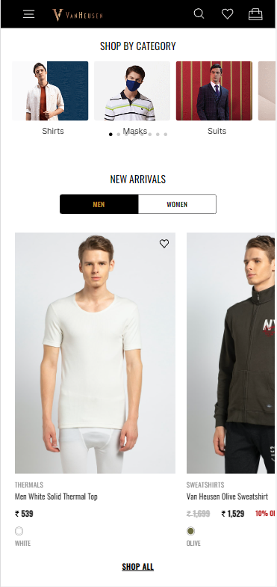
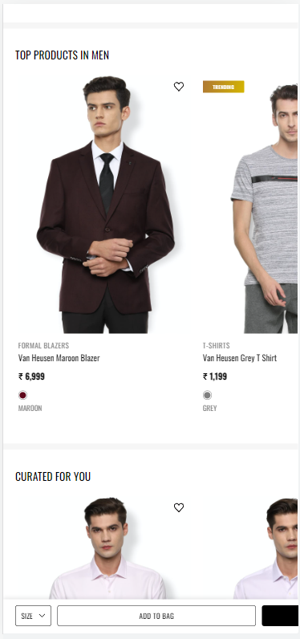
On Any Products click

Slide 8
Click Type | Tracking Type | Launch variables | Expected Values
Product clicks | All CTAs | const xdmData = {'eventType': 'analytics.track'}; const adobeDatalayer = { __adobe:{ analytics:{ products :"", linkType: 'o', contextData:{ linkName:"product click", channel: "<android/ios>|<page name without the word "page">", // eg : home, category, linkPageName: "<page name>", //the name of the page from where the product was clicked, eg : home page, product listing page , etc. customerID : "<customerID>", // only pass when available loginStatus : "<logged-in/guest>" , brand: "<brand name>", pfm : "<section of the page/ product finding source>", platform: "<android/ios>", userDetails: "<gender>|<age>", // pass only when user is logged in dob: "<date of birth>",// pass only when user is logged in eventType: 'click' } } } }; let experienceEvent = new ExperienceEvent({ xdmData: xdmData, data: adobeDatalayer }); Edge.sendEvent(experienceEvent) | loginStatus may have the values:- logged-in guest pfm means product finding method, the expected values will be the section of the page from where the user has found the product. Eg : "home product slider" "internal search" "internal campaign" "similar products" "top picks" "breadcrumb" "navigation/browsing" "promos" "wishlist/favorites" "collections" "cross-Sell" "campaign landing pages" stockStatus: provide whether product is in stock or out of stock eg – stockStatus : "out of stock" or "available" size: example values:- 42 L In brand, the expected values are f21 sc

Slide 9
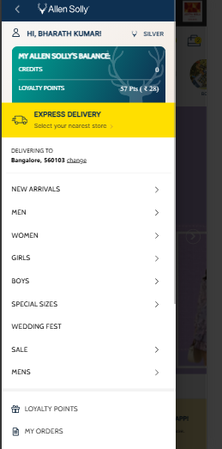
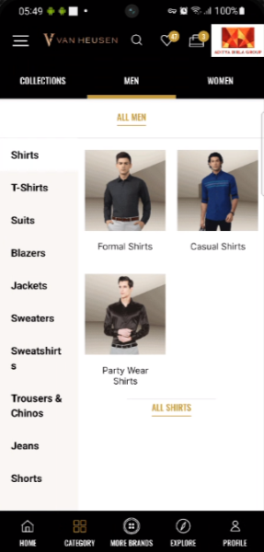
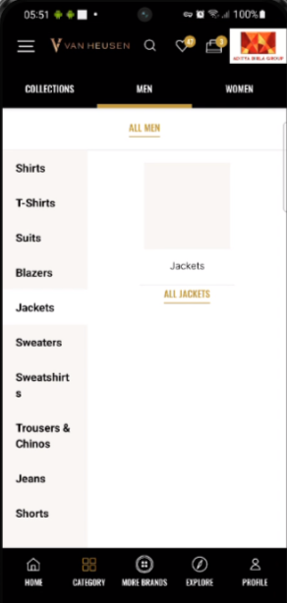
Menu Navigation Tracking

Slide 10
Click Type | Tracking Type | Launch variables | Expected Values
Menu-tracking | All CTAs | const xdmData = {'eventType': 'analytics.track'}; const adobeDatalayer = { __adobe:{ analytics:{ linkType: 'o', contextData:{ linkName:"<cta name>", channel: "<android/ios>|<page name from which menu is clicked without the word“page”>", //eg: home, category, customerID: "<customerID>", // only pass when available linkPageName: “<page name>", //the name of the page from where menu was clicked,eg: home page, plp, pdp brand: “<brand name>”, menuNav: "<level1:level1:level3>" loginStatus : "<logged-in/guest>" , platform: "<desktop website/mobile website>", userDetails: "<gender>|<age>", // pass only when user is logged in dob: "<date of birth>",pass only when user is logged i eventType: 'click' } } } }; let experienceEvent = new ExperienceEvent({ xdmData: xdmData, data: adobeDatalayer }); Edge.sendEvent(experienceEvent) | loginStatus may have the values:- logged-in guest <ctaName> will be the product category clicked, eg : polo T shirts, men, accessories In menuNAV, the expected values will be like level1- when user clicks on collection, men, women, sale, gifting, etc then menuNav value will be: men , women level2- when user clicks on shirts, tshirts, shuits, accessories, etc then menuNav value will be: men:shirts Men:wallets level3- when user clicks on casual shirts,formal blazers,socks , etc then menuNav value will be: Men: suits: formal suits Men:accessories:socks

Slide 11
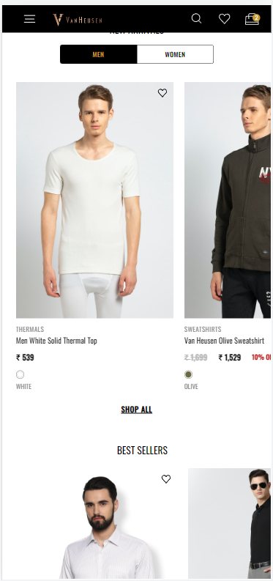
wishlist click

Slide 12
Click Type | Tracking Type | Launch variables | Expected Values
Add to/remove from wishlist | Icon | const xdmData = {'eventType': 'analytics.track'}; const adobeDatalayer = { __adobe:{ analytics:{ events: "<event4/event5>",// event4 only when add to Wishlist and event5 only when remove from Wishlist products : "", linkType: 'o', contextData:{ linkName: "<add to wishlist/remove from wishlist>", channel: "<android/ios>|home", linkPageName: "<page name>", brand: "<brand name>", customerID : "<customerID>", // only pass when available loginStatus : "<logged-in/guest>", platform: "<android/ios>", userDetails: "<gender>|<age>", // pass only when user is logged in dob: "<date of birth>", // pass only when user is logged in eventType: 'click' } } } }; let experienceEvent = new ExperienceEvent({ xdmData: xdmData, data: adobeDatalayer }); Edge.sendEvent(experienceEvent) | loginStatus may have the values:- logged-in guest productID: will have the value of SKU ID of the product. productCategory: will have the category of the product. Example:- shirt trouser productName: name of the product.

Slide 13
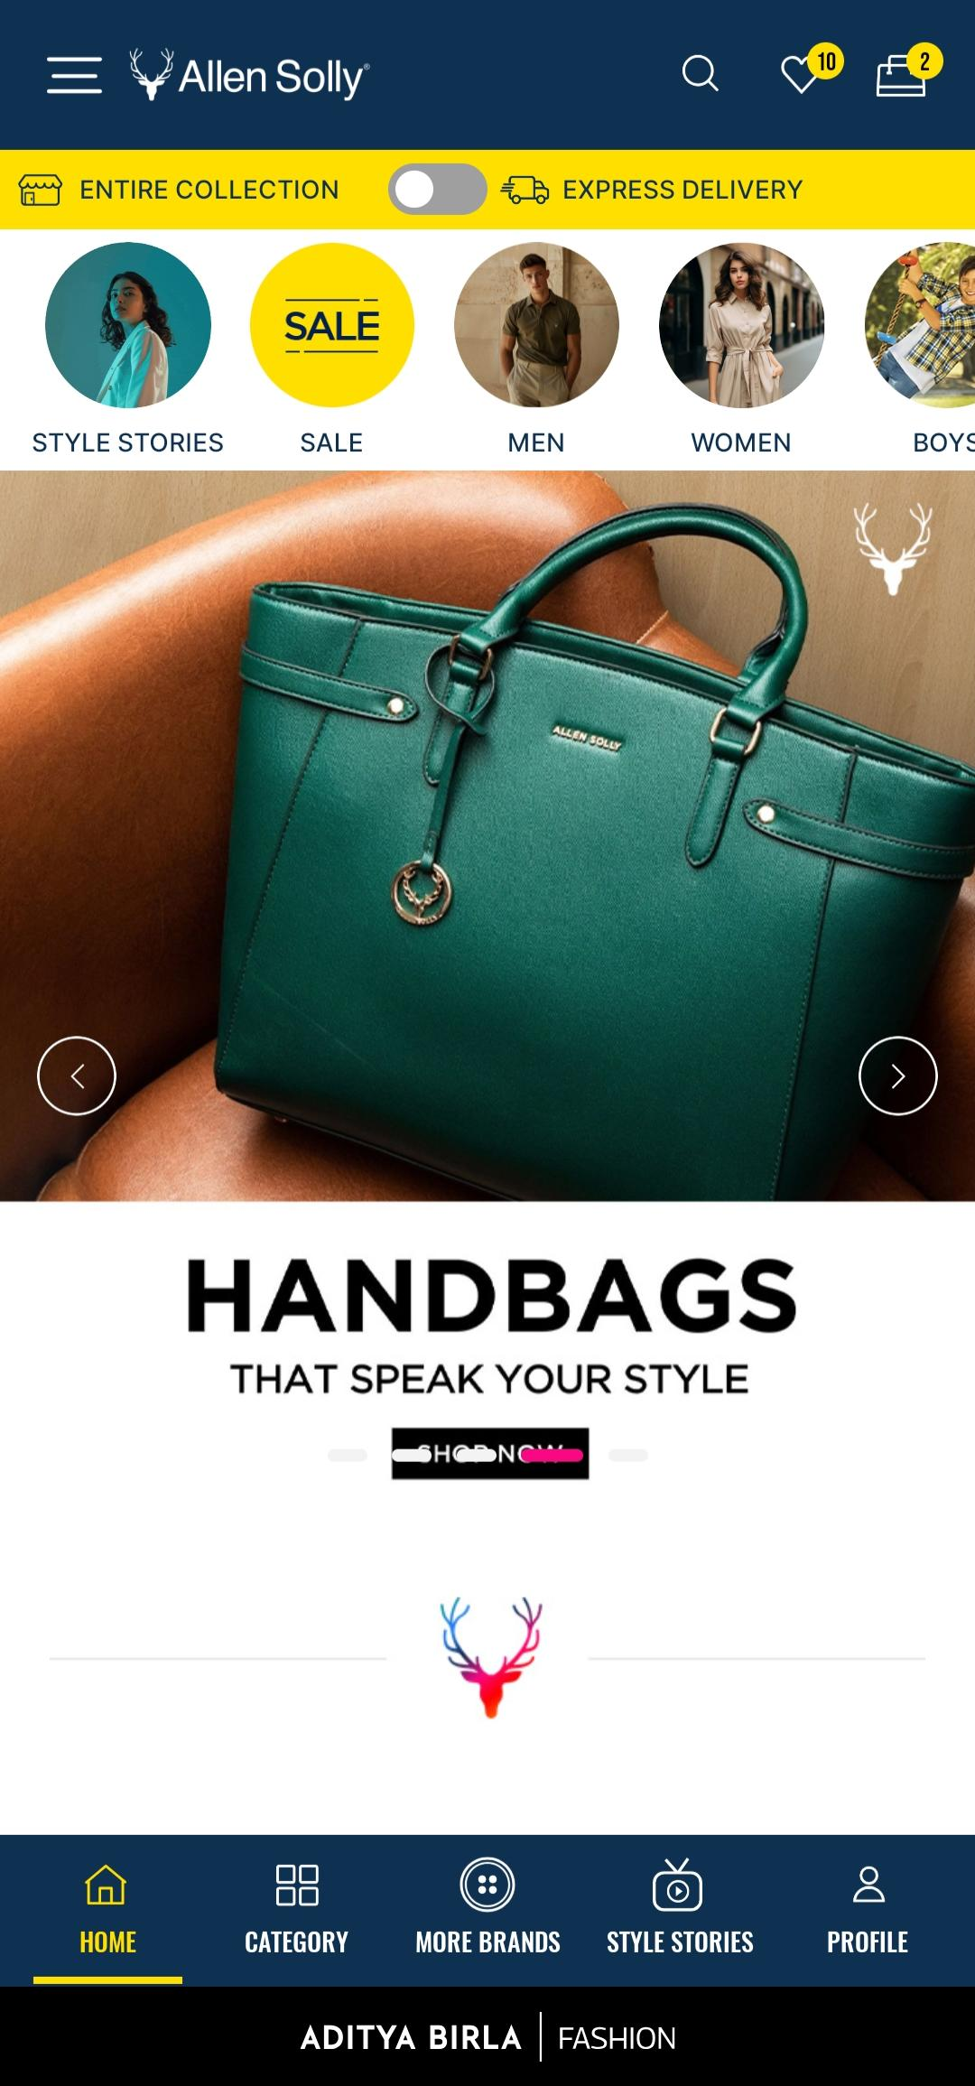
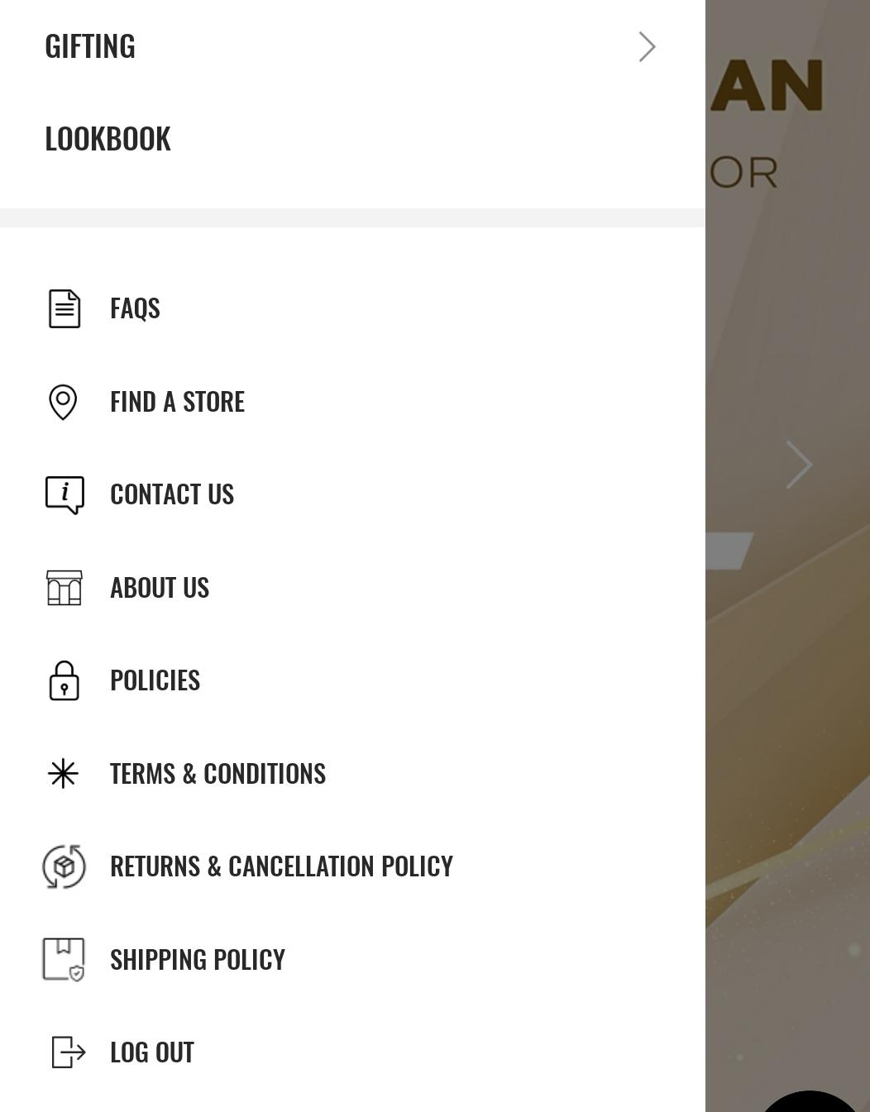
Footer clicks

Slide 14
Page Type | Tracking Type | Launch variables | Expected Values
Footer click | clicks | const xdmData = {'eventType': 'analytics.track'}; const adobeDatalayer = { __adobe:{ analytics:{ linkType: 'o', contextData:{ linkName : “<cta name>", channel: "<android/ios>|<page name without word page from which cta is clicked, // eg : home, category,etc. customerID : "<customerID>", // only pass when available linkPageName: "<page name>", //the name of the page from where the cta was clicked, eg : home page, product listing page , etc. loginStatus : "<logged-in/guest>" , brand: "<brand name>", platform: "<android/ios>", userDetails: "<gender>|<age>", // pass only when user is logged in dob: "<date of birth>", // pass only when user is logged in eventType: 'click' } } } }; let experienceEvent = new ExperienceEvent({ xdmData: xdmData, data: adobeDatalayer }); Edge.sendEvent(experienceEvent) | loginStatus may have the values:- logged-in guest

Slide 15
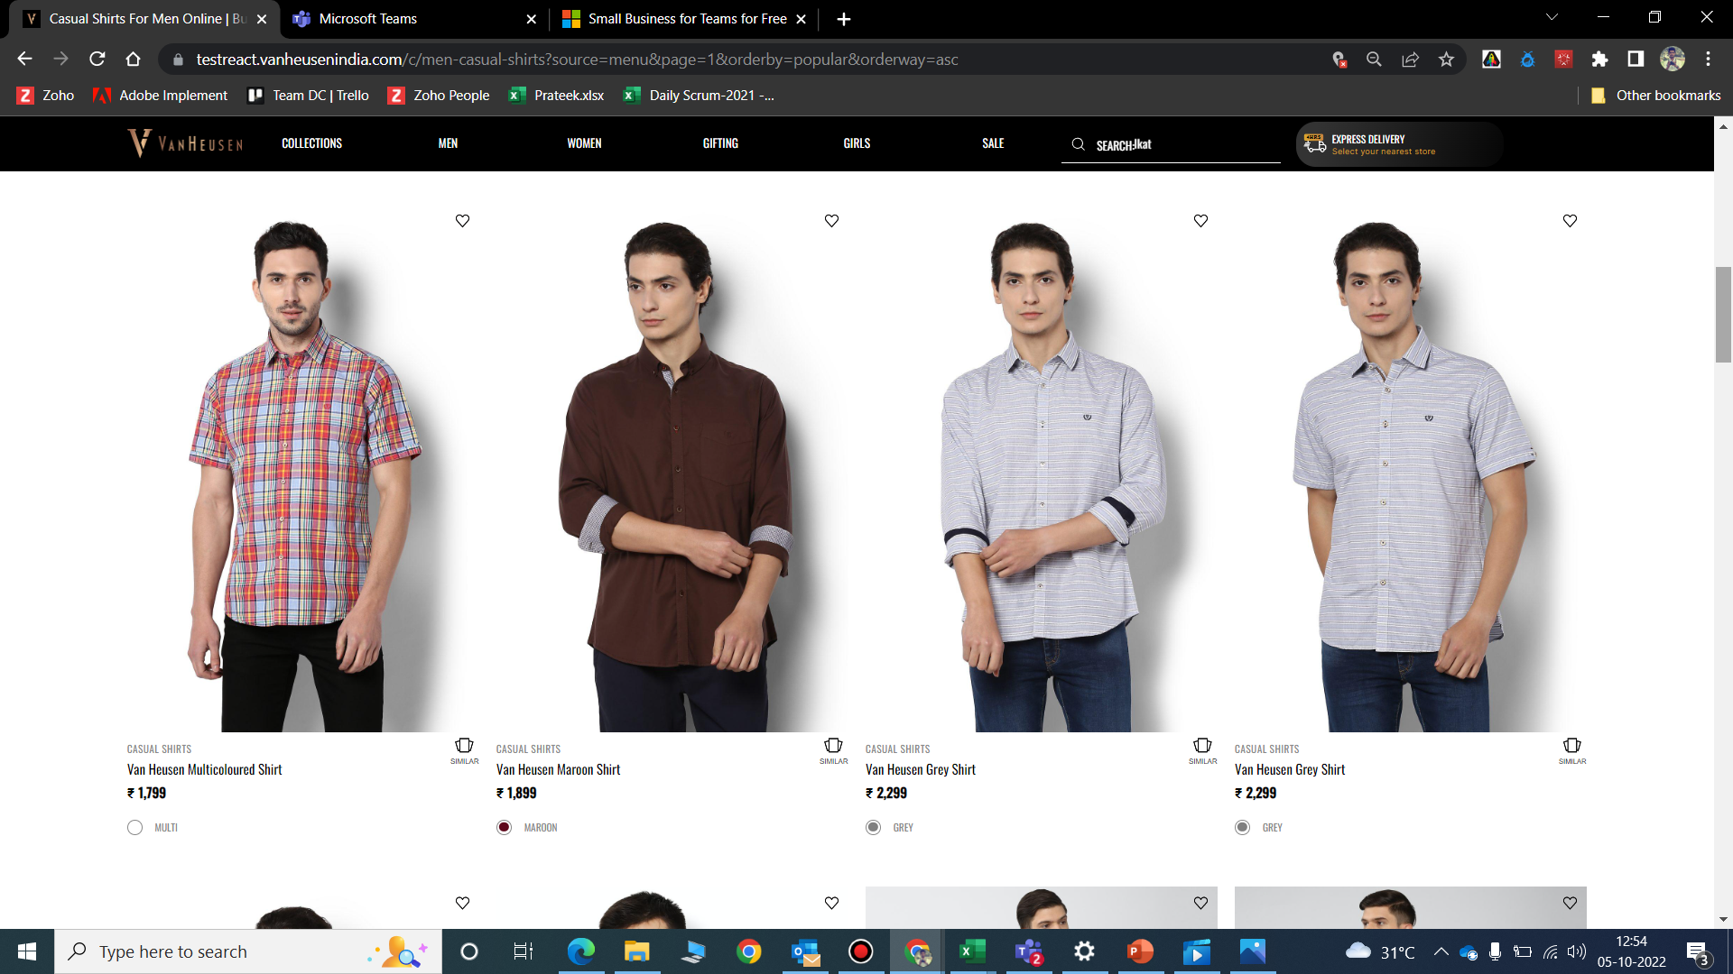
Similar products

Slide 16
Click Type | Tracking Type | Launch variables | Expected Values
View similar | Button | const xdmData = {'eventType': 'analytics.track'}; const adobeDatalayer = { __adobe:{ analytics:{ linkType: 'o', contextData:{ linkName: "similar products click", channel: "<android/ios>|<page name without term “page”>", linkPageName: "<page name>", brand: "<brand name>", customerID : "<customerID>", // only pass when available loginStatus : "<logged-in/guest>" , platform: "<android/ios>", userDetails: "<gender>|<age>", // pass only when user is logged in dob: "<date of birth>“, // pass only when user is logged in eventType: 'click' } } } }; let experienceEvent = new ExperienceEvent({ xdmData: xdmData, data: adobeDatalayer }); Edge.sendEvent(experienceEvent)

Slide 17
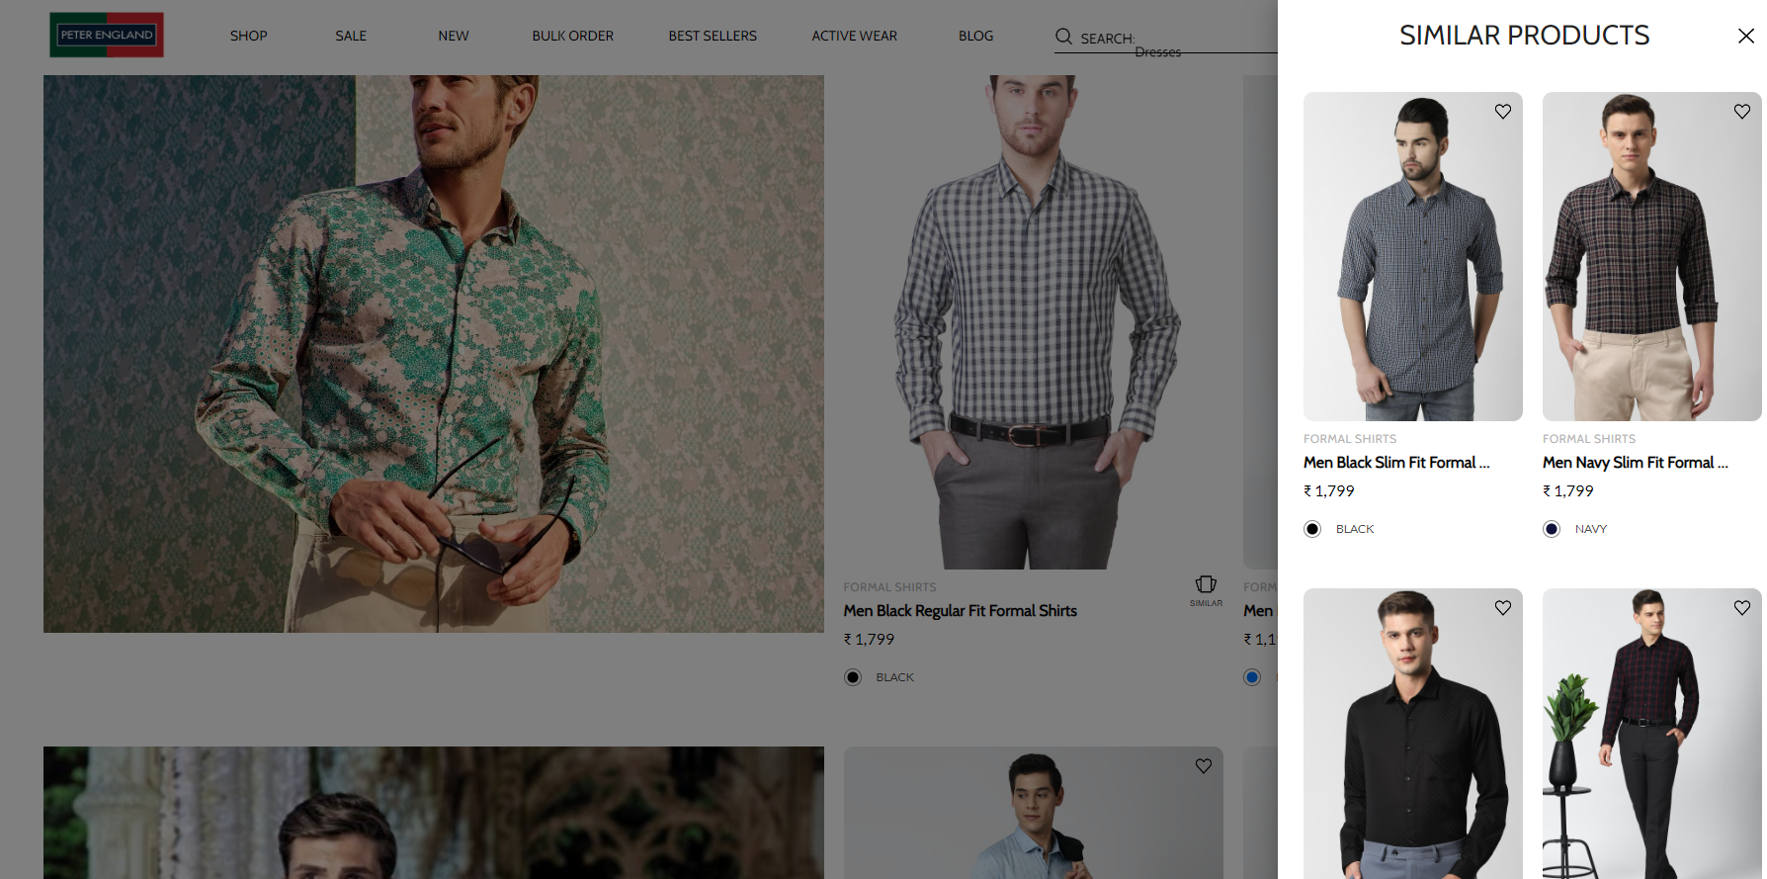
On showing similar products

Slide 18
Page Type | Tracking Type | Launch variables | Expected Values
Similar Product Page | View | const xdmData = {'eventType': 'analytics.track'}; const adobeDatalayer = { __adobe:{ analytics:{ pageName: "similar products", events: "event6", products : "", contextData:{ pageName: "similar products", parentPage: "<page name>“, channel: "<android/ios>|<page name without term “page”>", brand: "<brand name>", customerID : "<customerID>", // only pass when available loginStatus : "<logged-in/guest>" , pageType : "<brand name>-<page name>", platform: "<android/ios>", userDetails: "<gender>|<age>", // pass only when user has logged in dob: "<date of birth>", // pass only when user is logged in eventType: 'pageload' } } } }; let experienceEvent = new ExperienceEvent({ xdmData: xdmData, data: adobeDatalayer }); Edge.sendEvent(experienceEvent) // the products info passed here will the info of the product for whom similar products were available. | loginStatus may have the values:- logged-in guest In brand, the expected values are f21 sc productID: will have the value of SKU ID of the product. productCategory: will have the category of the product. Example:- shirt Trouser productName: name of the product.

Slide 19
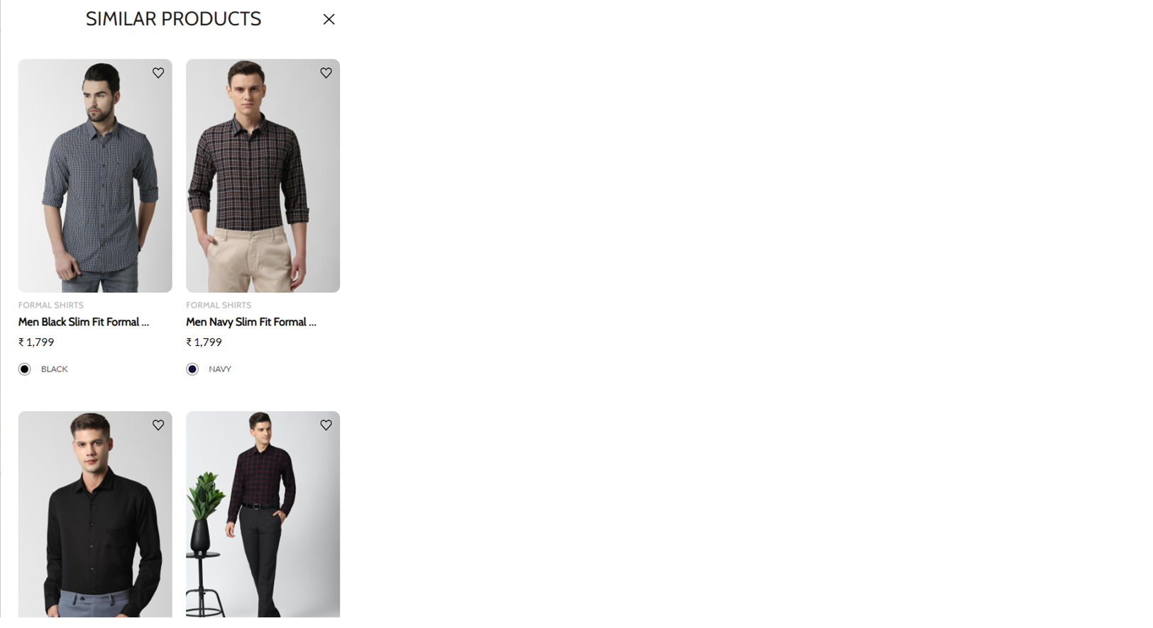
On click of Close

Slide 20
Click Type | Tracking Type | Launch variables | Expected Values
Close similar products | icon | const xdmData = {'eventType': 'analytics.track'}; const adobeDatalayer = { __adobe:{ analytics:{ linkType: 'o', contextData:{ linkName: "close-similar products", channel: "<android/ios>|<page name without term “page”>", linkPageName: "similar products", brand: "<brand name>", parentPage: "<page name>", customerID : "<customerID>", // only pass when available loginStatus : "<logged-in/guest>", platform: "<android/ios>", userDetails: "<gender>|<age>", // pass only when user is logged in dob: "<date of birth>", // pass only when user is logged in eventType: 'click' } } } }; let experienceEvent = new ExperienceEvent({ xdmData: xdmData, data: adobeDatalayer }); Edge.sendEvent(experienceEvent) | loginStatus may have the values:- logged-in guest In brand, the expected values are f21 sc

